Slide 1
agenda
Data analytics vs inferential statistics vs ML?
Descriptive stats … Lies?
Explore dataset [breakout room]

Slide 2
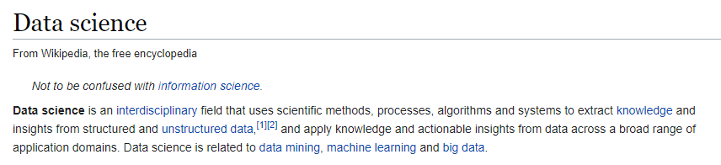
Data science
Statistics
Data science
Exploratory data analysis
Data analytics
What and why?
Notes:
<number>

Slide 3
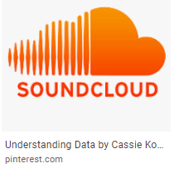
Data science
Make data useful

Slide 4
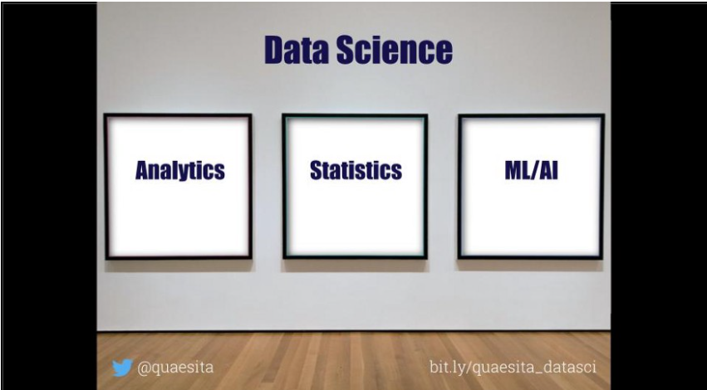
العركة؟
What’s the difference?

Slide 5
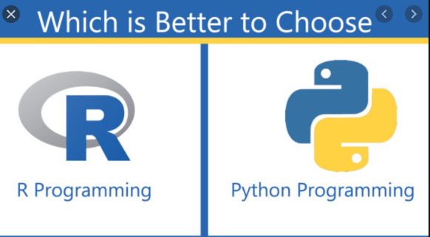

Analytics vs stats vs ML?
Notes:
The SQL vs R vs Python taxonomy is ill-advised for so many reasons, not least of which is that software evolves. (As of recently, you can even do ML in SQL.) Wouldn’t you prefer a breakdown that’ll last?
by the algorithm (surprise! it’s how university courses are structured). Pretty please, don’t taxonomize by histograms vs t-tests vs neural networks. Frankly, if you’re clever and you have a point to make, you can use the same algorithm for any part of data science. It might look like Frankenstein’s monster, but I assure you it can be forced to do your bidding.
<number>

Slide 6
Make data useful

Slide 7
العركة؟
What’s the difference?

Slide 8



Analytics vs (statistics/AI/ML/DP)

Slide 9

What u see?

Slide 10
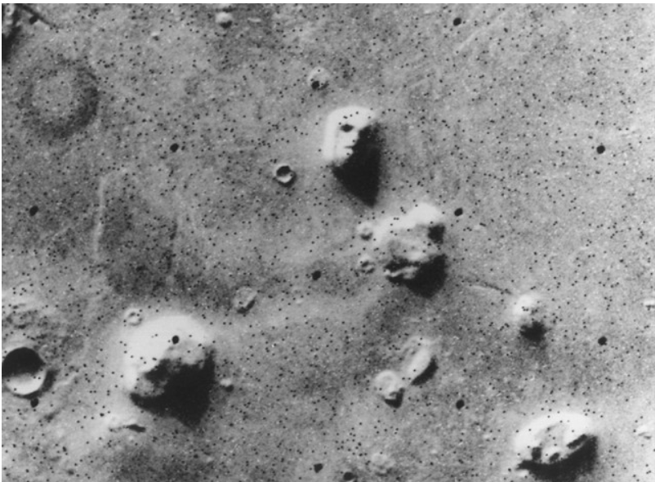

What u see, again?
12 sec shake?
Notes:
Satellite photo of the “Face on Mars” which many people took as evidence of extraterrestrial habitation.
How to know if there is indeed life on Mars? Test
How to know if 12 sec shake of ink can give u a butterfly image?
Retry
<number>

Slide 11
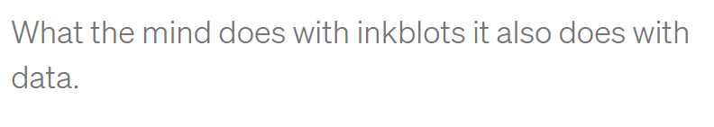
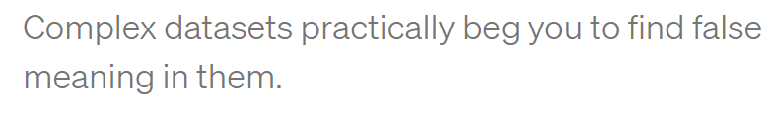

Slide 12
Analytics vs (statistics/AI/ML/DP)

Slide 13
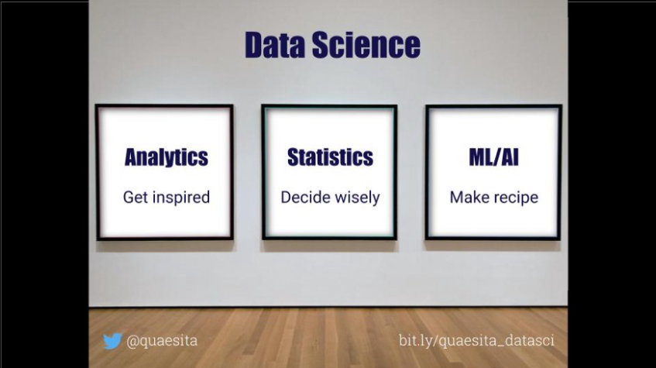

Slide 14
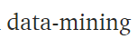
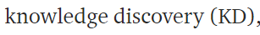
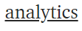
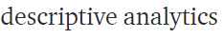
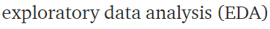
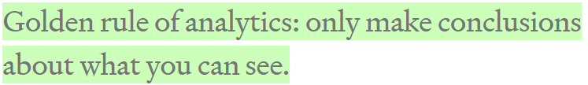
Data analytics
Notes:
The great news is that this one is easy. Think of your dataset as a bunch of negatives you found in a darkroom. Data-mining is about working the equipment to expose all the images as quickly as possible so you can see whether there’s anything inspiring on them. As with photos, remember not to take what you see too seriously. You didn’t take the photos, so you don’t know much about what’s off-screen. The golden rule of data-mining is: stick to what is here. Only make conclusions about what you can see, never about what you can’t see (for that you need statistics and lot more expertise).
<number>

Slide 15
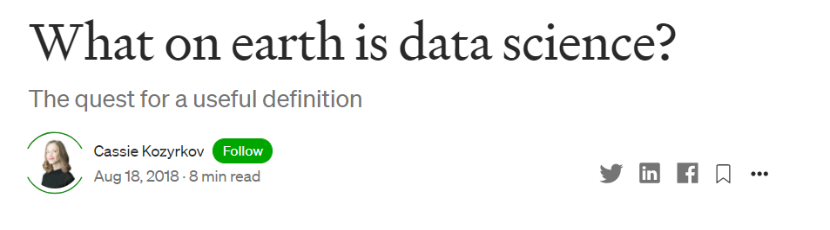
want more?
Notes:
What on earth is data science?. The quest for a useful definition | by Cassie Kozyrkov | HackerNoon.com | Medium
https://medium.com/hackernoon/what-on-earth-is-data-science-eb1237d8cb37
<number>

Slide 16
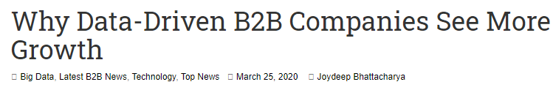

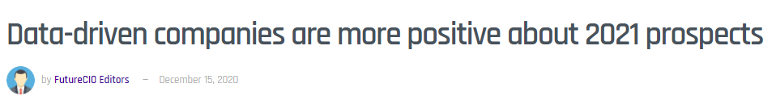
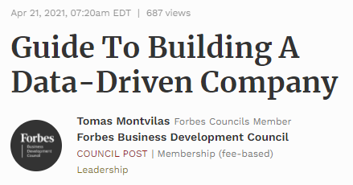
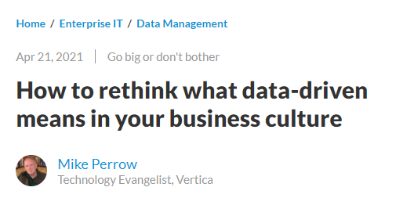

Slide 17

Data driven
Notes:
For a decision to be data-driven, it has to be the data — as opposed to something else entirely — that drive it. Seems so straightforward, and yet it’s so rare in practice because decision-makers lack a key psychological habit.
العربية الكارو محتاجة حمار عشان تبقى كارو
<number>

Slide 18

scenario
Notes:
Imagine that you are considering buying something online instead of making a pilgrimage to the other side of town to fetch it. You’ve boiled your decision down to whether or not you trust the online seller. A quick search yields some relevant data: you see that the seller has an average rating of 4.2 out of 5.
<number>

Slide 19
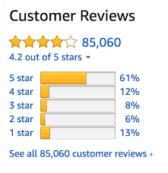
What u think?
Notes:
Now you can’t use that 4.2 to drive your decision. Game over! Once we’ve seen the answer, we’re free to pick the most convenient question. If the first thing we do is poke around in our data, our decision will be, at best, something I like to call data-inspired.
<number>

Slide 20
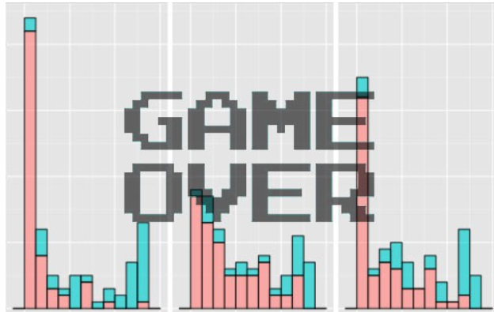
Data-drivenness destroyed
Any idea why?
Notes:
Once we’ve seen the answer, we’re free to pick the most convenient question
<number>

Slide 21
Data-drivenness destroyed
Once we’ve seen the
answer, we’re free to pick
the most convenient
question
Notes:
<number>

Slide 22
What u see, again?
12 sec shake?
Notes:
Satellite photo of the “Face on Mars” which many people took as evidence of extraterrestrial habitation.
How to know if there is indeed life on Mars? Test
How to know if 12 sec shake of ink can give u a butterfly image?
Retry
<number>

Slide 23
Notes:
Now you can’t use that 4.2 to drive your decision. Game over! Once we’ve seen the answer, we’re free to pick the most convenient question. If the first thing we do is poke around in our data, our decision will be, at best, something I like to call data-inspired.
<number>

Slide 24

Problem
How to solve?
Notes:
Problem: you’re free to move the goalposts after you find out where the data landed. (Of course you score a goal every time. You’re just that good.)
<number>

Slide 25


Solution
Notes:
set the goalposts in advance and resist temptation to move them later.
Framing the decision and setting decision criteria is a science of its own
a quick fix that goes a long way is to come up with your decision boundary up front in your data science project.
resis
<number>

Slide 26
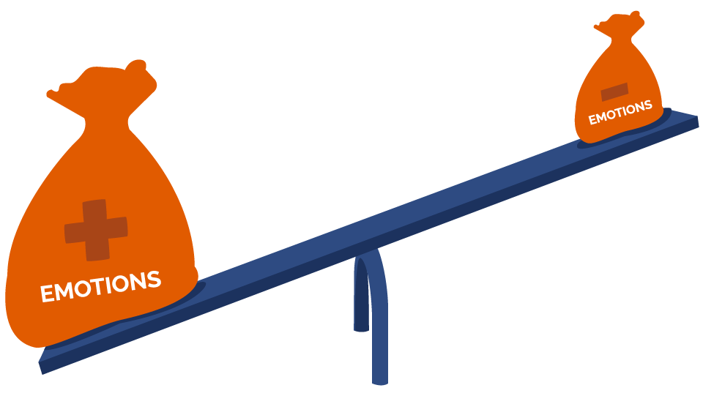

Notes:
That’s where we, like whales encountering plankton, swim around in some numbers, and then reach an emotional tipping point and… decide. There are numbers near our decision somewhere, but those numbers don’t drive it. The decision comes from somewhere else entirely.
<number>

Slide 27
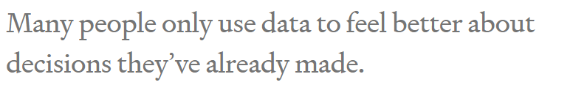
Notes:
<number>

Slide 28
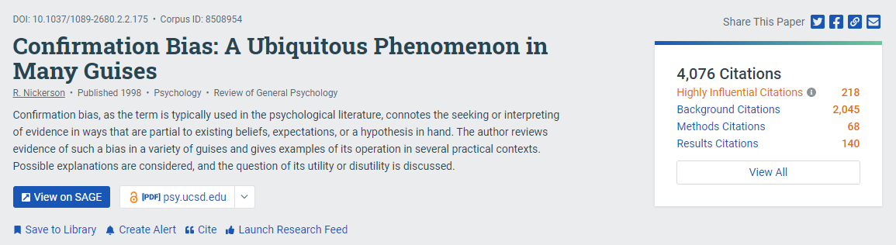
Notes:
The decision-maker’s mind was made up before the data, so the decision was there all along. Turns out humans interact with data selectively to confirm choices we’ve already made in our heart of hearts. We find the most convenient light in which to see evidence, and we don’t always know we’re doing it. Psychologists have a lovely name for this: confirmation bias.
<number>

Slide 29
Is it good?
Notes:
Positive
“It’s more than 4.0!”
They can even show a rigorous analysis about how it is statistically significantly higher than 4.0. (With certainty! It’s the p-value you’ve always wanted.)
Negative
“Why would I settle for a seller with less than 4.5 stars?” Or perhaps “But look at those 1-star reviews. I don’t like how many there are.” Sound familiar?
<number>

Slide 30
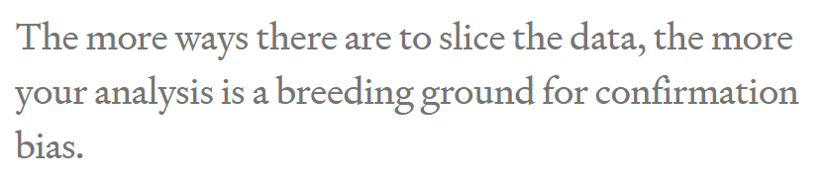

Slide 31

Solution
Notes:
Mathematical complexity doesn’t provide the antidote, it merely makes it harder to see the problem. As a result, what’s obvious in the trivial example we just saw becomes hidden in a jumble of gorgeous Gaussians. Don’t assume your friendly neighborhood data scientist sees it either. The more ways there are to slice the data, the more your analysis is a breeding ground for confirmation bias.
<number>

Slide 32
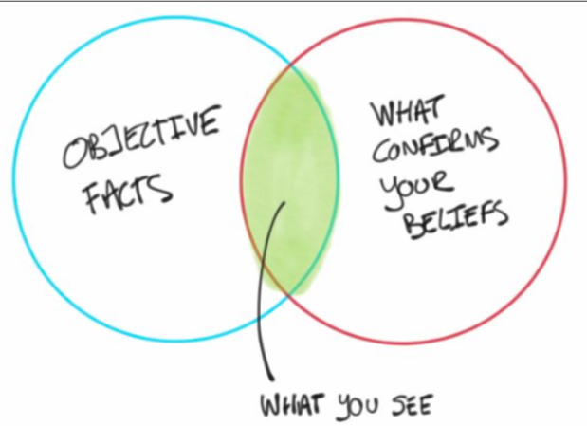
But why?

Slide 33

Notes:
feel better about doing what they were going to do anyway.
<number>

Slide 34


Any problem with real projects?
Notes:
It’s all about rating
What about a real pro
<number>

Slide 35
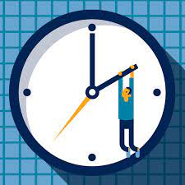


Expensive hobby

Slide 36

What’s the decision?
للأستاذة شيرين عبد الوهاب
Notes:
<number>

Slide 37

Notes:
When decision-makers lack fundamental skills, there’s no math in the world that can fix it. Your data science team will not contribute to data-driven decision-making.
<number>

Slide 38

What if?
Notes:
nothing would be different if all those poor data scientists just made some numbers up
<number>

Slide 39
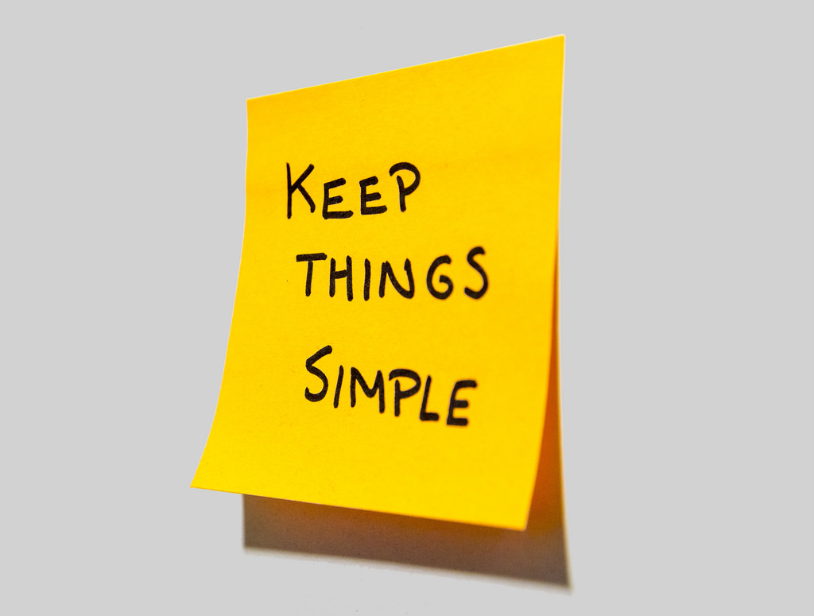

Cassie advice
Notes:
Data scientist friends, if your organization suffers from this kind of decision-maker, then I suggest sticking to the most lightweight and simple analyses to save time and money. Until the decision-makers are better trained, your showy mathematical jiu jitsu is producing nothing but dissipated heat.
<number>

Slide 40
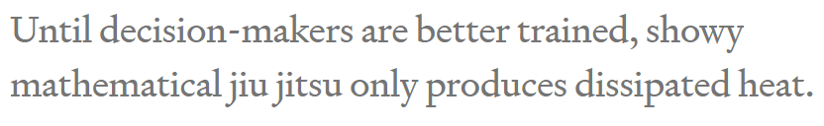

Slide 41
Problem
How to solve?
Notes:
Problem: you’re free to move the goalposts after you find out where the data landed. (Of course you score a goal every time. You’re just that good.)
<number>

Slide 42
Solution
Notes:
set the goalposts in advance and resist temptation to move them later.
Framing the decision and setting decision criteria is a science of its own
a quick fix that goes a long way is to come up with your decision boundary up front in your data science project.
resis
<number>

Slide 43

Practice
How to set goal first?

Slide 44

Solution
Notes:
she tugs at the pricetag on the back. “Hey, what does this say?” she asks me. “If it’s less than 80 bucks, I’ll buy it.”
<number>

Slide 45

Order matters
Notes:
Now that’s some decision intelligence! Instead of first seeing the price and then talking herself into a decision she’s already made, she uses the data to drive it. With a well-practiced reflex, she weighs how much she likes the dress and her budget, then sets the decision boundary, and only allows herself to see the data (price) once that’s done. She’s in the habit of using data in the right order and that’s a muscle you can exercise too.
<number>

Slide 46
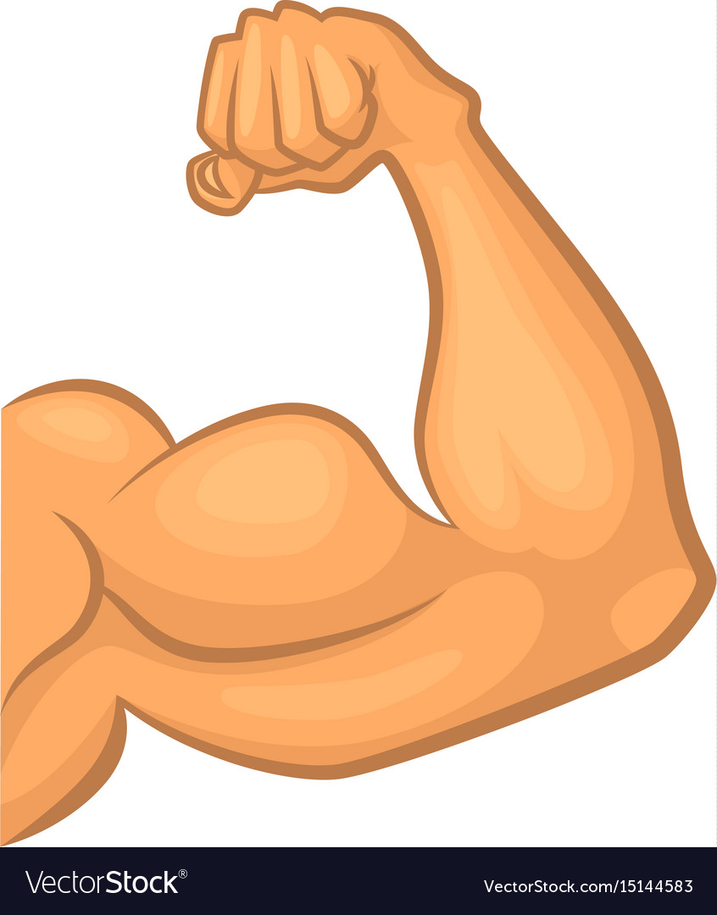
Practice your data driven muscle
Notes:
People don’t always need to be data-driven and Emma knows that. She doesn’t have to make unimportant decisions that way, but she also knows that practice makes perfect. It’s much easier to build the habit on trivial decisions than to struggle when the important ones come around.
<number>

Slide 47

Negotiation 101
Notes:
I went to buy fireworks
I sticked to 80 pounds
<number>

Slide 48

What if I didn’t ?

Slide 49
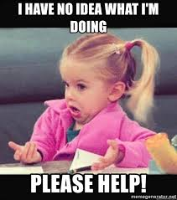
Notes:
In fact, standard advice for negotiators is to think through the entire range of potential offer combinations and plan your reactions to them in advance, otherwise it’s very easy for an experienced opponent to take advantage of you. Even without all the persuasion tactics at your counterpart’s disposal, irrelevant short-term factors like your blood sugar levels, your mood, how much the other party is smiling, and whether the sun is shining can have a disproportionate effect on the deal.
<number>

Slide 50
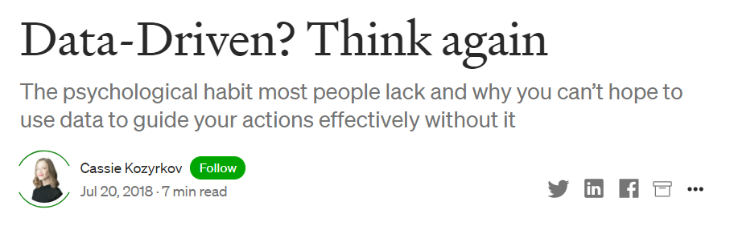

Notes:
Data-Driven? Think again. The psychological habit most people… | by Cassie Kozyrkov | HackerNoon.com | Medium
https://medium.com/hackernoon/data-inspired-5c78db3999b2
<number>

Slide 51
Topics in sessions
Quant vs cat
Ordinal vs nominal
Cont vs discrete
Centrality and spread
Random variable
Outliers
Desc vs inf stats

Slide 52
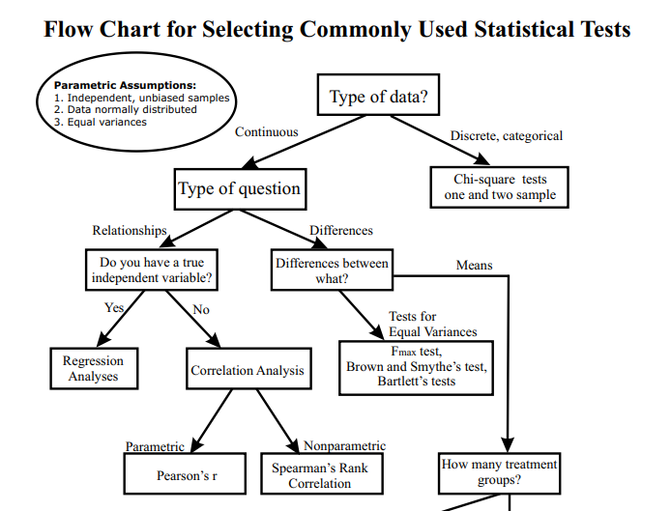
انت جاي تعمل ايه؟

Slide 53
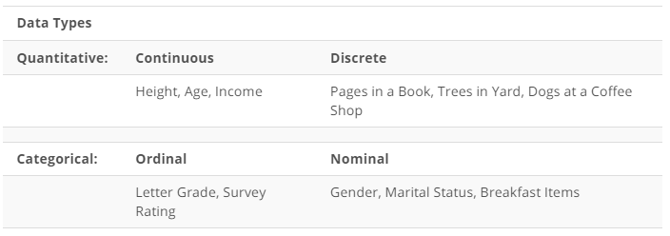

Slide 54
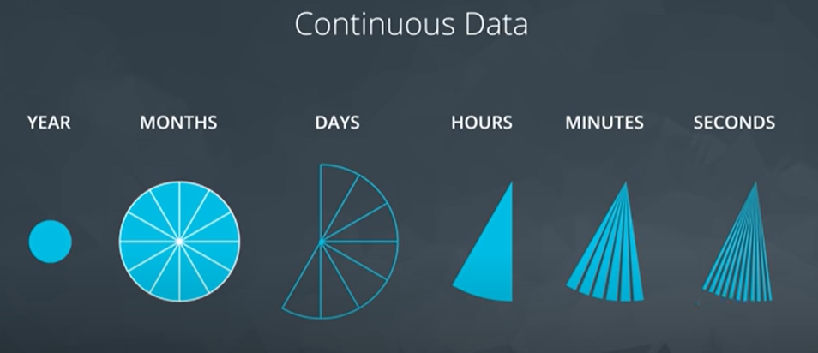
Notes:
What about discrete data?
<number>

Slide 55
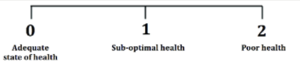
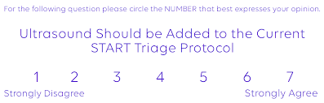
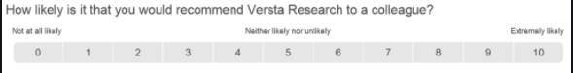
Data type
Notes:
Which can be converted to continuous ?
3 points … never
7 points … maybe
10 points .. Probably yes
<number>

Slide 56
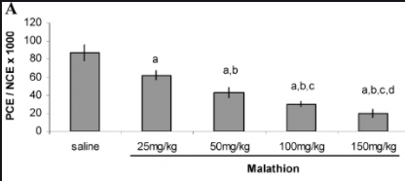
Data type
Notes:
Ordinal or nominal?
I think nominal..
But maybe if we changed saline to 0
Maybe it turns to be ordinal
<number>

Slide 57
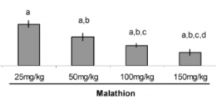
Data type
Notes:
Can be Nominal or ordinal
<number>

Slide 58
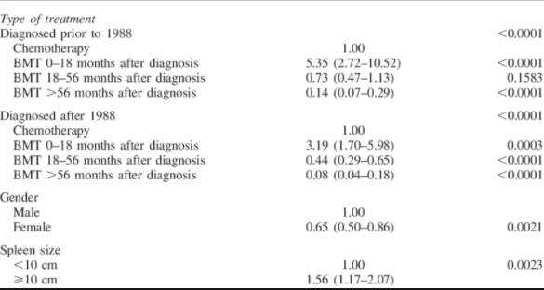
Bone marrow transplantation
Notes:
Spleen size> what’s the data type
Formerly : continuous
Then categorical
Time from bmt to diagnosis
Continuous then categorical maybe ordinal
Is it outcome variable … ordinal makes sense
Is it a predictor . Maybe order matters, like Cochrane Armitage
<number>

Slide 59
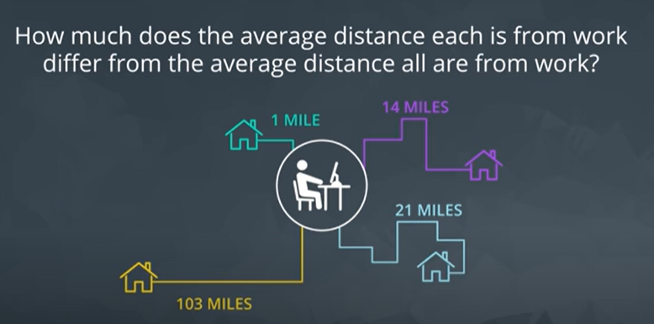
Standard deviation
Notes:
Standard deviation
Just a single estimate for the data spread
<number>

Slide 60
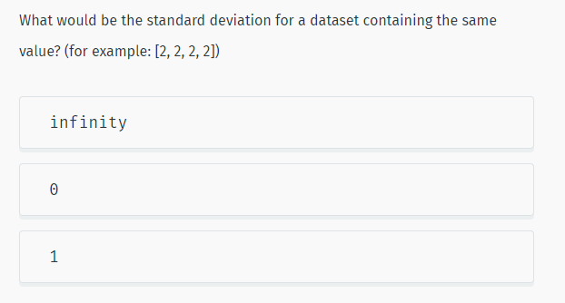
Notes:
More Statistics | SoloLearn
https://www.sololearn.com/learning/1161/4778/12271/2
<number>

Slide 61
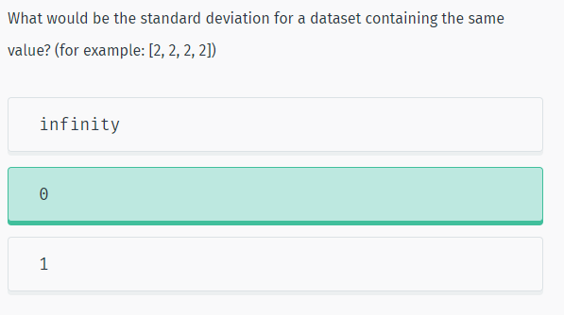
Solution

Slide 62
How to choose?
Range vs IQR
Mean vs median
Notes:
When to choose boxplot over histogram?
Normality : mean
Skewed : median /IQR / maybe range if no outliers
Outliers : IQR
<number>

Slide 63
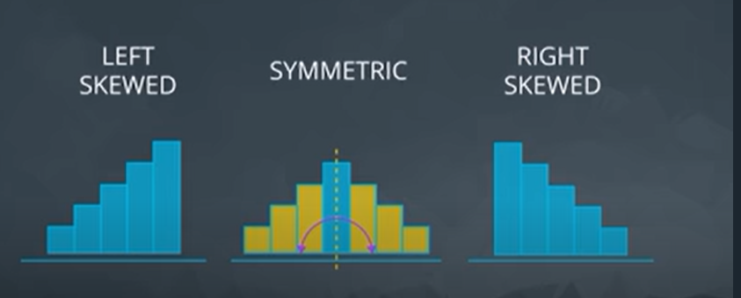
solution
Notes:
<number>

Slide 64
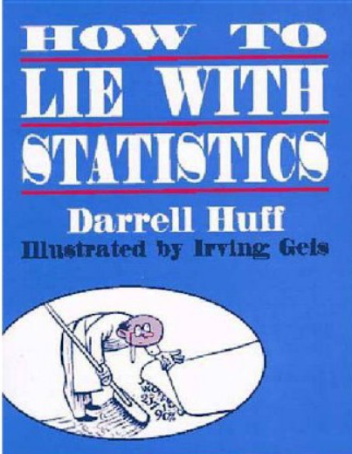
65 years old

Slide 65


Two hospitals
100 child per day
10 child per day
Notes:
<number>

Slide 66
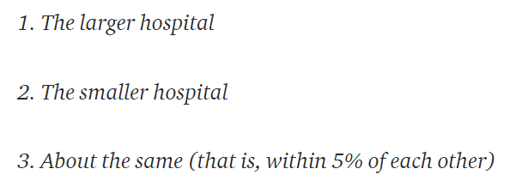
Hospital with more boys?
For 1 year, each hospital recorded no. of days where 60% of the babies born were boys.
- Which hospital do you think recorded more such days?
Notes:
A certain town is served by two hospitals. In the larger hospital, about 45 babies are born each day, and in the smaller hospital, about 15 babies are born each day. As you know, about 50% of all babies are boys. However, the exact percentage varies from day to day. Sometimes it may be higher than 50%, sometimes lower.
For a period of 1 year, each hospital recorded the days on which more than 60% of the babies born were boys. Which hospital do you think recorded more such days?
If you guessed 2., then congratulations, you are data literate! The reasoning is the smaller the sample size, the more extreme the values.
<number>

Slide 67

4 heads out of 5?
Notes:
You can test the principle that small samples produce extreme results by flipping a coin. With a small sample, say 5 tosses, there is a good chance you get 4 tails. Does this mean the coin always comes up 80% tails? No, this means your sample is too small to draw any significant conclusions.
This trick is often used when marketing products by asking a small number of people about a particular brand. You can get impressive-sounding numbers (90% of doctors like this toothpaste) if you repeatedly survey small groups and only report the favorable results. Ask a small group, look at the results, throw away the bad, and repeat until you get the stats you need!
<number>

Slide 68
Conclusion?
Small Samples Produce Shocking Statistics
Avoid fishing

Slide 69
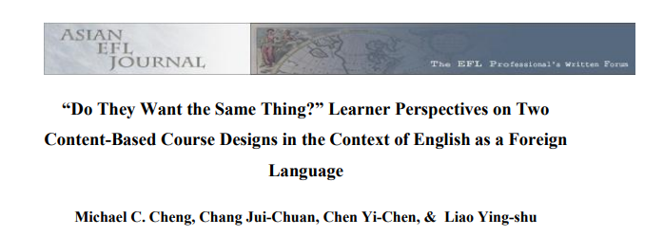
Academic papers?
“over70 percent of the students preferred language-skills courses over other courses”
“of the 41 percent who planned to seek employment, an overwhelming majority of respondents (82%)disliked the idea of content-driven design (Design 1)”
Notes:
In their study on learner perspectives in the context of English as a ForeignLanguage, Cheng, Jui-Chuan, Yi-Chen and Ying-shu (2010: 79) found that “over70 percent of the students preferred language-skills courses” over other courses, which seems quite a lot. They furthermore add that “of the 41 percent who plannedto seek employment, an overwhelming majority of respondents (82%)disliked theidea of content-driven design (Design 1)” (Cheng et al. 2010: 80). The reader hasto be very diligent here and go back to the methodology section where the authorsexplain that they included only 96 participants in their study, which is“approximately 35% of the target population” (Cheng et al. 2010: 75). Hence, from274 students, a number that was not directly stated, the authors were able to ask96, which means that 35% represent the target group. From these 96 students, 41%“plan to seek employment”. This makes 39 students. 82% of these 39 students,meaning 32 students, are described as “an overwhelming majority” who “dislikedthe idea of content-driven design” (Cheng et al. 2010: 80). In the end, however,the authors only refer to 32 out of274 students. “Overwhelming” does thereforedefinitely not seem fitting. This example shows that students should be aware thatthe reference sample might be quite small and not be of importance yet still beemphasised in several studies. It should not be confused with the larger overallsample.
(11) (PDF) Statistics Can Lie! – Using Descriptive Statistics in Academic Writing to Shape Reader’s Interpretations | Jessica Dheskali - Academia.edu
https://www.academia.edu/43624921/Statistics_Can_Lie_Using_Descriptive_Statistics_in_Academic_Writing_to_Shape_Reader_s_Interpretations
<number>

Slide 70
Back to methodology section
274 students
“over70 percent of the students preferred language-skills courses over other courses”
“of the 41 percent who planned to seek employment, an overwhelming majority of respondents (82%)disliked the idea of content-driven design (Design 1)”
96 participants
39 students
32 students
Notes:
In their study on learner perspectives in the context of English as a ForeignLanguage, Cheng, Jui-Chuan, Yi-Chen and Ying-shu (2010: 79) found that “over70 percent of the students preferred language-skills courses” over other courses, which seems quite a lot. They furthermore add that “of the 41 percent who plannedto seek employment, an overwhelming majority of respondents (82%)disliked theidea of content-driven design (Design 1)” (Cheng et al. 2010: 80). The reader hasto be very diligent here and go back to the methodology section where the authorsexplain that they included only 96 participants in their study, which is“approximately 35% of the target population” (Cheng et al. 2010: 75). Hence, from274 students, a number that was not directly stated, the authors were able to ask96, which means that 35% represent the target group. From these 96 students, 41%“plan to seek employment”. This makes 39 students. 82% of these 39 students,meaning 32 students, are described as “an overwhelming majority” who “dislikedthe idea of content-driven design” (Cheng et al. 2010: 80). In the end, however,the authors only refer to 32 out of274 students. “Overwhelming” does thereforedefinitely not seem fitting. This example shows that students should be aware thatthe reference sample might be quite small and not be of importance yet still beemphasised in several studies. It should not be confused with the larger overallsample.
(11) (PDF) Statistics Can Lie! – Using Descriptive Statistics in Academic Writing to Shape Reader’s Interpretations | Jessica Dheskali - Academia.edu
https://www.academia.edu/43624921/Statistics_Can_Lie_Using_Descriptive_Statistics_in_Academic_Writing_to_Shape_Reader_s_Interpretations
<number>

Slide 71
Conclusion?
Small numbers again
Beware of percentages!

Slide 72



Iq test
Notes:
two children, one of whom tests a 99 on IQ and the other a 102, you really should not tell them to avoid comparisons. Why? Because IQ tests can have a standard error of around 3 points which means a child scoring a 99 once would be expected to score between 96 and 102 about 68% of the time. The overall difference might not be significant and could reverse itself in repeated testing. In other words, by leaving out the expected standard error in the results, you can draw a more drastic conclusion than that offered by the data.
<number>

Slide 73
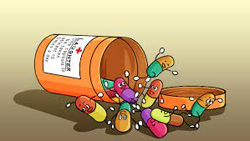
increased lifespan by 2 years on average
Notes:
Think of it this way: if there was a medicine that increased lifespan by 2 years on average would you take it? Would it change your mind if the worst impact was a loss of 12 years of life and the maximum a gain of 14 years? It usually is the details that matter and one summary statistic cannot tell the whole story.
<number>

Slide 74
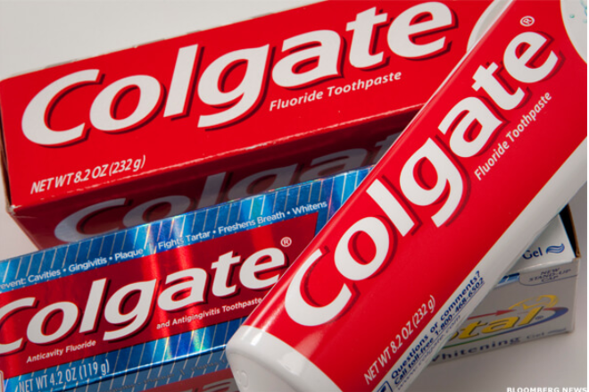
More than 80% of Dentists recommend Colgate
Notes:
Misleading Statistics & Data – News Examples For Misuse of Statistics
https://www.datapine.com/blog/misleading-statistics-and-data/
<number>

Slide 75
More than 80% of Dentists recommend Colgate
In 2007, Colgate was ordered by the
Advertising Standards Authority (ASA)
of the U.K. to abandon their claim
Why?
Notes:
<number>

Slide 76
The question
Which toothpaste do u recommened? (more than 1 answer possible)
colgate
sensodyne
Miswak
…
Notes:
The claim, which was based on surveys of dentists and hygienists carried out by the manufacturer, was found to be misrepresentative as it allowed the participants to select one or more toothpaste brands. The ASA stated that the claim “… would be understood by readers to mean that 80 percent of dentists recommend Colgate over and above other brands, and the remaining 20 percent would recommend different brands.”
<number>

Slide 77

misleading
Come back ☺
Small numbers??
Notes:
The ASA continued, “Because we understood that another competitor’s brand was recommended almost as much as the Colgate brand by the dentists surveyed, we concluded that the claim misleadingly implied 80 percent of dentists recommend Colgate toothpaste in preference to all other brands.” The ASA also claimed that the scripts used for the survey informed the participants that the research was being performed by an independent research company, which was inherently false.
Maybe small numbers of surveys is also a similar problem
U survey 10 dentists. By chance u get very good results. U keep them
And remove other results that were unfavorable
<number>

Slide 78
Conclusion?
Multiple answer questions …. A totally different scenario!

Slide 79

Where is the mean?

Slide 80

politicians, marketers,
and CEOs
Notes:
For example, the mean and median income in the United States differ by about $16,000. By choosing which value to report as the average, politicians, marketers, and CEOs can draw opposing conclusions from the same data.
How to avoid?
The way to avoid this is to look at the mean, median, and mode of a dataset (again you need all these numbers!). Figure out which one is most appropriate (usually the median for highly skewed datasets such as income, city size, life span, housing prices and so on) and use that if you need a one figure summary. If you can, graph the entire set of values in a histogram and look at the distribution. Try to use more than a single number to describe a dataset, and if you report an average, specify which you are using!
<number>

Slide 81
90% of Drivers Consider Themselves Above Average
What u think?
Notes:
wow, other people are terrible at evaluating themselves objectively.”
Although a headline like this is often used to illustrate the illusion of superiority, (where people overestimate their competence) it also provides a useful lesson in clarifying your assertions when you talk statistics about data. In this particular case, we need to differentiate between the mean and median of a set of values. Depending on the question we ask, it is possible for 9/10 drivers to be above average.
How 90% of Drivers Can be “Above Average” or Why You Need to be Careful When Using Statistics | by Will Koehrsen | Towards Data Science
https://towardsdatascience.com/how-90-of-drivers-can-be-above-average-or-why-you-need-to-be-careful-when-talking-statistics-3df7be5cb116
<number>

Slide 82

And now?
What do we call this point?
Notes:
The distinction is whether we use mean or median for “average” driver skill. Using the mean, we add up all the values and divide by the number of values, giving us 8.03 for this dataset. Since 9 of the 10 drivers have a skill rating greater than this, 90% of the drivers could be considered above average!
The median, in contrast, is found by ordering the values from lowest to highest and selecting the value where half the data points are smaller and half are larger. Here it’s 8.65 with 5 drivers below and 5 above. By definition, 50% of drivers are below the median and 50% exceed the median. If the question is “do you consider yourself better than 50% of other drivers?” than 90+% of drivers cannot truthfully answer in the affirmative.
outlier
<number>

Slide 83
Makes sense?
“Majority of people live longer than average”
Notes:
An example of a negatively skewed distribution is age at death. In this dataset, there are, unfortunately, some deaths at a relatively young age, lowering the mean and skewing the graph leftward (negatively).
In the case of a negative skew, the median is greater than the mean. The result is that more people can be above the “average” when the average is defined as mean. “Majority of people live longer than average” might be a strange headline, but if you choose your stats carefully, you can make it true.
<number>

Slide 84

Makes sense?
“Majority of people live longer than average”
Notes:
An example of a negatively skewed distribution is age at death. In this dataset, there are, unfortunately, some deaths at a relatively young age, lowering the mean and skewing the graph leftward (negatively).
In the case of a negative skew, the median is greater than the mean. The result is that more people can be above the “average” when the average is defined as mean. “Majority of people live longer than average” might be a strange headline, but if you choose your stats carefully, you can make it true.
<number>

Slide 85
Conclusion?
When to use mean/median?

Slide 86

☹ ☹
289 murders in 2018
Notes:
<number>

Slide 87
Context ☺ ☺
289 murders in 2018
2245 murders in 1990
Notes:
You can scare people by saying New York had 289 murders in 2018, but when you compare that to 2245 in 1990, you realize New York City has never been safer! It’s usually the comparison that matters; don’t let an isolated number sway your rational thinking.
<number>

Slide 88

Unemployment
2019 20%
2020 13%

Slide 89

Changed definition
Notes:
The easiest way to lower unemployment is just to change the definition to exclude people who have stopped looking for work.
<number>

Slide 90
Conclusion?
Always have a reference
Check definitions and ensure their consistency

Slide 91
Don’t Place Too Much Faith in any One Statistic
“How to Lie with Statistics” ➔ view any single statistic with skepticism.
Any number represents a distillation of a set of data, which was taken on a sample of a population by mistake-prone humans, using imperfect tools, in constantly changing conditions at a single point in time.
Notes:
The overall theme of “How to Lie with Statistics” is: view any single statistic with skepticism.
Any number represents a distillation of a set of data, which was taken on a sample of a population by mistake-prone humans, using imperfect tools, in constantly changing conditions at a single point in time.
<number>

Slide 92
Enough?
The data was analyzed by another human, who works for an institution, which may have outside funders with differing motivations. Finally, the statistic or graph was delivered to you by a publisher that has its own interests in getting you to believe one idea.
Notes:
All this leads to two conclusions:
If you put all your faith in one number, then you will be overfitting to the particular circumstances that produced the number.
Statistics and data are never purely objective. A statistic is one interpretation of uncertain data designed to persuade.
We should look for the range of values, report numbers with confidence intervals, gather more data before jumping to conclusions, compare multiple studies, and ask about the design of the data-gathering process
<number>

Slide 93

Want to learn more?
Notes:
Lessons on How to Lie with Statistics | by Will Koehrsen | Towards Data Science
https://towardsdatascience.com/lessons-from-how-to-lie-with-statistics-57060c0d2f19
<number>

Slide 94
Enough lies. Let’s work!
How to conduct descriptive statistics?
How to make ur life easier?

Slide 95


Real life

Slide 96



Different specialties

Slide 97

https://pypi.org/project/tableone/
Notes:
tableone · PyPI
https://pypi.org/project/tableone/
<number>

Slide 98



What happened?
Notes:
Continuous variables : mean SD
Categorical variables : frequency percentage
Grouped by outcome
<number>

Slide 99

More flexibility?
http://www.danieldsjoberg.com/gtsummary/
Notes:
Presentation-Ready Data Summary and Analytic Result Tables • gtsummary
http://www.danieldsjoberg.com/gtsummary/
<number>

Slide 100


Slide 101




Slide 102



Slide 103


Slide 104


Notes:
My objective is to argue that only a small subset of the library is sufficient to complete nearly all of the data analysis tasks that one will encounter.
Minimally Sufficient Pandas. In this article, I will offer an… | by Ted Petrou | Dunder Data | Medium
https://medium.com/dunder-data/minimally-sufficient-pandas-a8e67f2a2428
<number>

Slide 105

Aim
Notes:
Know why limiting Pandas to a small subset will keep your focus on the actual data analysis and not on the syntax
Have specific guidelines for taking a single approach to completing a variety of common data analysis tasks with Pandas
<number>

Slide 106

Minimally Sufficient Pandas
Have almost everything
Analysis not syntax
Notes:
It is a small subset of the library that is sufficient to accomplish nearly everything that it has to offer.
It allows you to focus on doing data analysis and not the syntax
Your code will be simple, explicit, straightforward, and boring
You will choose one obvious way to accomplish a task
You will use this obvious way every single time
You won’t have to retain as many commands in working memory
Your code will be easier to understand by others and by you
<number>

Slide 107


Standardizing common tasks
Notes:
Better collaboration
Lesser memorization
<number>

Slide 108


No Tricks
Notes:
Knowing many obscure Pandas tricks might impress your friends, but it doesn’t usually lead to good code
It can lead to long lines of code that are difficult to understand and may be harder to debug.
شوف ده وشوف ده
<number>

Slide 109


Let’s start
Notes:
The concrete examples were all derived by the following principle:
If a method does not provide any additional functionality over another method (i.e. its functionality is a subset of another) then it shouldn’t be used. Methods should only be considered if they have some additional, unique functionality.
Will koehrson
<number>

Slide 110

Selecting a Single Column of Data
Select state, color, fav food
and count
NB 2
Notes:
How to select state, color favorite food and count?
Notice that when selecting count, it states at the top ‘bound method DataFrame.count of’. Python is telling us that this is a method of some DataFrame object.
Also I can’t select fav food by dot notation
Will cover isA
<number>

Slide 111

The column name is a variable
Notes:
Failure
<number>

Slide 112

Autocompletion?

Slide 113

Notes:
Which AI Code Autocomplete Should You Choose? | The Startup
https://medium.com/swlh/kite-vs-tabnine-which-ai-code-autocomplete-should-you-choose-eb6eba85c3a6#:~:text=TabNine%20was%20released%20in%202019,Atom%2C%20Sublime%20Text%2C%20etc.
<number>

Slide 114

Notes:
<number>

Slide 115

How to select rows and columns?
ix
loc
iloc
at
Iat

Slide 116


ix indexer
Why was it deprecated?
Notes:
The ix indexer was created in the early days of Pandas to select rows and columns by both label and integer location.
This turned out to be quite ambiguous as Pandas row and column names can be both integers and strings.
<number>

Slide 117
Solution?
loc ➔ label
iloc ➔ integer location
Notes:
Deprecated : مهملة
Move to jupyter
<number>

Slide 118
How to select rows and columns?
ix
loc
iloc
at
iat

Slide 119

Selection with at and iat
Only a single cell
Notes:
select a single cell of a DataFrame
These provide a slight performance advantage over their analogous loc and ilocindexers. But, they introduce the additional burden of having to remember what they do. Also, for most data analyses, the increase in performance isn’t useful unless it’s being done at scale. And if performance truly is an issue, then taking your data out of a DataFrame and into a NumPy array will give you a large performance gain.
<number>

Slide 120
How to select rows and columns?
ix
loc
iloc
at
Iat
Notes:
The documentation uses the term position for referring to integer location. I do not like this terminology as I feel it is confusing. Integer location is more descriptive and is exactly what .iloc stands for.
python - pandas loc vs. iloc vs. at vs. iat? - Stack Overflow
https://stackoverflow.com/questions/28757389/pandas-loc-vs-iloc-vs-at-vs-iat
A perfect ans by Ankit Agrawal
<number>

Slide 121
Method Duplication
Which one to choose?
Notes:
The isna method was added more recently because the characters na are found in other missing value methods such as dropna and fillna. Confusingly, Pandas uses NaN, None, and NaT as missing value representations and not NA.
<number>

Slide 122

Method Duplication
Which one to choose?
Do we need notna?
Notes:
The isna method was added more recently because the characters na are found in other missing value methods such as dropna and fillna. Confusingly, Pandas uses NaN, None, and NaT as missing value representations and not NA.
There are aliases. Choose whichever u like
<number>

Slide 123

Solution
Notes:
You can also avoid ever using notna since Pandas provides the inversion operator, ~ to invert boolean DataFrames.
<number>

Slide 124



Builtin Python vs Pandas
Which one
To use?
NB 4
Notes:
<number>

Slide 125

Two datasets?
CONCAT
APPEND
JOIN
MERGE
Notes:
<number>

Slide 126

Two datasets

Slide 127

SQL?
NB Combining dataframes
Notes:
<number>

Slide 128


Ignore index
What to expect?
Notes:
<number>

Slide 129


Solution
Notes:
<number>

Slide 130

How to group and aggregate?
Notes:
finding the maximum SAT score per state
<number>

Slide 131



Guidance

Slide 132

Multiindex
How to?
How to remove?
Notes:
Relaffil = rel affiliation
A MultiIndex or multi-level index is a cumbersome addition to a Pandas DataFrame that occasionally makes data easier to view, but often makes it more difficult to manipulate. You usually encounter a MultiIndex after a call togroupby when using multiple grouping columns or multiple aggregating columns.
Here Both the rows and columns have a MultiIndex with two levels.
They have different syntax for making subset selections and are more difficult to use with other methods. If you are an expert Pandas user, you can get some performance gains when making subset selections,
<number>

Slide 133


Any difference?
Modify to
Get the
multiindex

Slide 134

Solution
How to revert
multilevel index?

Slide 135




Rename and reset
Rename columns
Reset index
Notes:
Guidance: Avoid using a MultiIndex. Flatten it after a call to groupby by renaming columns and resetting the index.
<number>

Slide 136

groupby vs pivot_table vs crosstab vs pivot

Slide 137



Which is which?
Wide vs
Long?
When to use?
Notes:
Groupby vs pivot_table
The wide format is the pivot table
Guidance: use pivot_table when comparing groups
I really like to use pivot tables to compare values across groups and a groupby when I want to continue an analysis. From above, it is easier to compare male to female salaries when using the output of pivot_table. The result is easier to digest as a human and its the type of data you will see in an article or blog post. I view pivot tables as a finished product.
The result of a groupby is going to be in tidy form, which lends itself to easier subsequent analysis, but isn’t as interpretable
<number>

Slide 138

Tidy
Notes:
Tidy Data | Wickham | Journal of Statistical Software
https://www.jstatsoft.org/article/view/v059i10
<number>

Slide 139

Similar?

Slide 140


pivot_table vs pd.crosstab
Notes:
The pivot_table method and the crosstab function can both produce the exact same results with the same shape. They both share the parameters index, columns, values, and aggfunc. The major difference on the surface is that crosstab is a function and not a DataFrame method.
<number>

Slide 141

How to get with pivot_table?

Slide 142

How to get with pivot_table?
What about cross_tab?
Notes:
<number>

Slide 143

With cross_tab

Slide 144

Want relative frequency?

Slide 145

Pretty easy
Notes:
You also have the option of normalizing over the rows using the string ‘index’ or over the entire DataFrame with the string ‘all’ as seen below.
<number>

Slide 146

Normalizing over rows or df
Notes:
You also have the option of normalizing over the rows using the string ‘index’ or over the entire DataFrame with the string ‘all’ as seen below.
<number>

Slide 147
Bottom line
Cross_tab easier for frequency
It seems that it can do everything
I think I can recommend it over pivot_table

Slide 148

Pivot vs pivot_table

Slide 149

No aggregation
Notes:
Using the pivot method, reshapes the data without aggregating or doing anything to it. pivot_table, on the other hand, requires that you do an aggregation
<number>

Slide 150


Pivot Pitfalls
Notes:
it can only handle the case when both index and columns are set to a single column. If you want to keep multiple columns in the index then you cannot use pivot. Also, if any combination of index and columns appear more than once, then you will get an error as it does not perform an aggregation.
pivot_table can accomplish all of what pivot can do. In the case that you do not need to perform an aggregation, you still must provide an aggregation function.
I think cross_tab is a better alternative
<number>

Slide 151


Melt vs stack
How to reshape?
Notes:
Let’s reshape this data so that we have three columns, the airline, the airport and the arrival delay
<number>

Slide 152
Using melt
What about stack??
Notes:
Let’s reshape this data so that we have three columns, the airline, the airport and the arrival delay
<number>

Slide 153



Using stack
Set index
Use stack

Slide 154
Compare melt/stack output
melt
stack
How to revert multi-index?
Notes:
This returns a Series with a MultiIndex with two levels.
<number>

Slide 155



Slide 156



Melt advantage
Notes:
Renaming on the fly
<number>

Slide 157
Do we need apply?
Consider discussing this
But after reading more about `
Notes:
Also see this Perfect post on stackoverflow
python - When should I (not) want to use pandas apply() in my code? - Stack Overflow
https://stackoverflow.com/questions/54432583/when-should-i-not-want-to-use-pandas-apply-in-my-code#:~:text=It%20is%20because%20apply%20is,major%20overhead%20at%20each%20iteration.
How and why to stop using pandas .apply() (so much) | by Sven Harris | Towards Data Science
https://towardsdatascience.com/avoiding-apply-ing-yourself-in-pandas-a6ade4569b7f
<number>

Slide 158

Apply vs map vs applymap
Notes:
Introduction to Pandas apply, applymap and map | by B. Chen | Towards Data Science
https://towardsdatascience.com/introduction-to-pandas-apply-applymap-and-map-5d3e044e93ff
<number>

Slide 159



Apply
Can we use lambda?

Slide 160

Apply

Slide 161


Apply
Can we use lambda?
Notes:
<number>

Slide 162

Apply

Slide 163

Notes:
applymap() is only available in DataFrame and used for element-wise operation across the whole DataFrame. It has been optimized and some cases work much faster than apply() , but it’s good to compare it with apply() before going for any heavier operation.
<number>

Slide 164



Slide 165

map

Slide 166



map
Notes:
map() is only available in Series and used for substituting each value in a Series with another value. To understand how the map() works, we first create a Series.
map() accepts a dict or a Series. Values that are not found in the dict are converted to NaN, unless the dict has a default value (e.g. defaultdict):
<number>

Slide 167

Notes:
To avoid applying the function to missing values (and keep them as NaN) na_action='ignore' can be used:
<number>

Slide 168












Best of the API
Notes:
<number>

Slide 169










Useful notebook extensions
Notes:
10 Jupyter Notebook Extensions Making My Lyfe Easier | by Max Tingle | Medium
https://medium.com/@maxtingle/10-jupyter-notebook-extensions-making-my-lyfe-easier-f40139a334ce
If you want to view the full traceback, you can click the triangle/drop-down arrow at the end of the summary to unhide the traceback.
Ever find yourself adding a bunch of cells in your notebook to test code as you debug? And do those cells just get in the way later?
Once enabled, Scratchpad is a cell that acts like a scratch notebook where you can execute code against the kernel without having to modify your notebook. Scratchpad cells are executed using “Shift+Enter” like a regular cell, and you can use the icon in the bottom-right of the screen or the keyboard shortcut “Ctrl+B” to toggle Scratchpad.
And this is where extensions really start doing the work for you. The Snippets Menu extension adds a menu item to your Jupyter Notebook where you can search for snippets, boilerplate, and examples of code to insert into your notebook.
The first time you open a notebook with initialization cells enabled, a warning will display saying the notebook is untrusted. You can choose to trust the notebook, after which the notebook will re-open in trusted mode and run your initialization cells.
Turn on the cell toolbar within your notebook menu using “View > Cell Toolbar > Initialization Cell.”
<number>

Slide 170

RUN ALL CELLS?

Slide 171


Inferential statistics

Slide 172


Notes:
Get more examples
<number>

Slide 173

Conduct a study!

Slide 174
What u think?
“A statewide antibody study estimates that 21% of New York City residents have had the coronavirus, Cuomo says.”

Slide 175

Trust ☺
Notes:
Ya3ny eh?
If lopsided results are misleading, that doesn’t necessarily mean that they were born out of the intent to mislead. Perhaps they were, perhaps they weren’t. Statistical bias can come about through negligence, ignorance, expediancy, or shenanigans.
<number>

Slide 176

What is bias?
What’s variance?
Notes:
<number>

Slide 177

Notes:
High bias doesn’t mean you’re shooting all over the place (that’s high variance), but may cause a perfect archer hit below the bullseye all the time.
<number>

Slide 178


Slide 179
Bias/variance? Over or under?
“A statewide antibody study estimates that 21% of New York City residents have had the coronavirus, Cuomo says.”
What u think?
Notes:
Over or under estimation?
Over estimation
The true is low
Why? I smell the pungent odor of randomization issues with how the data were obtained, which brings me to statistical subdefinition #2.
<number>

Slide 180

Indoor?
Notes:
What clever thing did they do to collect data from people who stay indoors?
As it turns out, no clever thing.
<number>

Slide 181
Questions to ask?
What’s the probability the study measured someone who is fully self-quarantined?
How many NYC residents are keeping themselves entirely to themselves?
Notes:
Zero.
We don’t know.
<number>

Slide 182

conclusion
Notes:
Selection bias
A special way to trigger results that are systematically off the mark is to collect your data in a problematic manner. For statisticians who love having things to be grumpy about, selection bias is a cherished frenemy. It visits so often!
Selection bias occurs when different members of your population of interest have different probabilities of arriving in your sample.
In other words, you’re making conclusions from your sample as if it were drawn randomly while it was drawn, er, “randomly” instead.
<number>

Slide 183

Notes:
In that case, your sample isn’t representative of your population… which makes your conclusions untrustworthy.
If your population of interest is all New York City residents, then you don’t have a random sample (SRS) unless every single New York City resident has equal probability of being included. Is that requirement met by the NY antibody study? Definitely not.
<number>

Slide 184
Undercoverage bias
How to solve?
Notes:
<number>

Slide 185

Solution
“all NYC residents who go outside”
Notes:
One pragmatic quick fix for undercoverage bias is to settle for a less ambitious population definition. Instead of trying to make inferences about “all NYC residents” you could choose instead to talk about “all NYC residents who go outside” — problem solved!
<number>

Slide 186

Now fixed?
The study tested people “at
grocery and big-box stores.”
Any problem?
Notes:
Let’s see how the data were gathered. The study tested people “at grocery and big-box stores.” If you’d like increase your probability of exposure, where do you go? To places with a higher density of people, like grocery and big-box stores. Where was the study done? Yup.
<number>

Slide 187

Grocery frequent visits
Notes:
How about if you really, really, really want to get the virus? You might go to grocery and big-box stores frequently… more frequently than someone who’s trying to reduce their probability of infection. Of these two kinds of people, which kind of person would be more likely to have COVID-19 antibodies? Which do you think would be more likely to be in the right place at the right time to participate in the study? Hello, selection bias!
<number>

Slide 188

volunteer bias ?
Notes:
volunteer bias because he suspects he was infected, or currently infected
<number>

Slide 189
How to solve?
Notes:
Biased archers have it easy — if you keep hitting the target above the center, at least you can see it and make adjustments. Researchers with selection bias aren’t so lucky. Selection bias means all your results are wrong and you don’t know how wrong.
<number>

Slide 190

No Solution ☹

Slide 191

Notes:
Is this enough?
<number>

Slide 192

Biased conclusions
PCR sensitivity
threshold
Notes:
information bias occurs when measurements are systematically incorrect.
Have u heard of PCR sensitivity?
What if they only detect antibodies above a strict threshold to avoid false alarms?
<number>

Slide 193
Information vs selection
خالصين ؟
Notes:
<number>

Slide 194
Conclusion about population?
What do we know about NYC residents’ actual exposure rate?
Notes:
Exposure rate : we know Nothing
<number>

Slide 195
Conclusion about population?
What do we know about NYC residents’ actual exposure rate?
- What do we know for sure?
Notes:
What we know for sure?
Some people at grocery and big box stores got an exciting readout from something called an antibody test.
<number>

Slide 196
Business Insider
“preliminary”
sampling issues
So where is the problem?
Notes:
To be fair to Business Insider, I think they did a pretty good job of reporting. They even called the results “preliminary” and mentioned some of the same sampling issues I talked about. Kudos! These are the same properly-cautious noises originally made by the governor of NY and the team who ran the study. I have no beef with them either. Instead, my complaint is with the broken telephone game that the rest of the internet is playing.
<number>

Slide 197


What is the problem?
Soret el telephone el 5arban
Notes:
Instead, my complaint is with the broken telephone game that the rest of the internet is playing.
<number>

Slide 198

Most common
1- Read all article?
2- say I haven’t read
3- report the title only?
Notes:
What most frequently occurs on whatsapp?
Report the title only.
<number>

Slide 199

Reporting bias

Slide 200
When reporting bias happens?
Journal club?
Twitter?
Trick
Feel better
Advertising a scientific article
Notes:
Make pithy summaries of complicated things (e.g. to squeeze everything into a 280 character tweet).
Prevent readers’ eyes from glazing over (e.g. journalists editorializing scientific publications).
Persuade someone through trickery (e.g. conveniently “forgetting” to mention studies that cast doubt on the arguments you’re hoping to make).
Feel better about their opinions (e.g. when they’re suffering from confirmation bias).
<number>

Slide 201
Is the study worthless?
Notes:
Does this mean that the study is worthless? No, but it’s only as good as the assumptions you’ll make about it. Since there’s very little that we know for sure from its data, the only way to make inferences beyond the facts is to bridge the gap with assumptions. That’s all statistics is. Assumptions, not magic.
Unfortunately, we’re not all equally qualified to make good assumptions that lead to useful conclusions. For example, while I am a statistician with plenty of real-world data collection experience, I’m not an expert in antibody tests, so you shouldn’t trust me to make wise assumptions about their accuracy. Excellent! I don’t trust me either, so I’ll end up learning nothing about the virus exposure rate of NYC. The study is worthless in my hands.
<number>

Slide 202
Is the study worthless?
As good as the assumptions
Notes:
Does this mean that the study is worthless? No, but it’s only as good as the assumptions you’ll make about it. Since there’s very little that we know for sure from its data, the only way to make inferences beyond the facts is to bridge the gap with assumptions. That’s all statistics is. Assumptions, not magic.
Unfortunately, we’re not all equally qualified to make good assumptions that lead to useful conclusions. For example, while I am a statistician with plenty of real-world data collection experience, I’m not an expert in antibody tests, so you shouldn’t trust me to make wise assumptions about their accuracy. Excellent! I don’t trust me either, so I’ll end up learning nothing about the virus exposure rate of NYC. The study is worthless in my hands.
<number>

Slide 203

Notes:
Were 21% of New York City residents really infected with the novel coronavirus? | by Cassie Kozyrkov | Towards Data Science
https://towardsdatascience.com/were-21-of-new-york-city-residents-really-infected-with-covid-19-aab6ebefda0
<number>

Slide 204
Simpson’s paradox revisited?

Slide 205
How to group and aggregate?
Notes:
finding the maximum SAT score per state
<number>

Slide 206
Guidance

Slide 207
Multiindex
How to?
How to remove?
Notes:
Relaffil = rel affiliation
A MultiIndex or multi-level index is a cumbersome addition to a Pandas DataFrame that occasionally makes data easier to view, but often makes it more difficult to manipulate. You usually encounter a MultiIndex after a call togroupby when using multiple grouping columns or multiple aggregating columns.
Here Both the rows and columns have a MultiIndex with two levels.
They have different syntax for making subset selections and are more difficult to use with other methods. If you are an expert Pandas user, you can get some performance gains when making subset selections,
<number>

Slide 208
Any difference?
Modify to
Get the
multiindex

Slide 209
Solution
How to revert
multilevel index?

Slide 210
Rename and reset
Rename columns
Reset index
Notes:
Guidance: Avoid using a MultiIndex. Flatten it after a call to groupby by renaming columns and resetting the index.
<number>

Slide 211
groupby vs pivot_table vs crosstab vs pivot

Slide 212
Which is which?
Wide vs
Long?
When to use?
Notes:
Groupby vs pivot_table
The wide format is the pivot table
Guidance: use pivot_table when comparing groups
I really like to use pivot tables to compare values across groups and a groupby when I want to continue an analysis. From above, it is easier to compare male to female salaries when using the output of pivot_table. The result is easier to digest as a human and its the type of data you will see in an article or blog post. I view pivot tables as a finished product.
The result of a groupby is going to be in tidy form, which lends itself to easier subsequent analysis, but isn’t as interpretable
<number>

Slide 213
Tidy
Notes:
Tidy Data | Wickham | Journal of Statistical Software
https://www.jstatsoft.org/article/view/v059i10
<number>

Slide 214
Similar?

Slide 215
pivot_table vs pd.crosstab
Notes:
The pivot_table method and the crosstab function can both produce the exact same results with the same shape. They both share the parameters index, columns, values, and aggfunc. The major difference on the surface is that crosstab is a function and not a DataFrame method.
<number>

Slide 216
Want relative frequency?

Slide 217
Pretty easy
Notes:
You also have the option of normalizing over the rows using the string ‘index’ or over the entire DataFrame with the string ‘all’ as seen below.
<number>

Slide 218
Normalizing over rows or df
Notes:
You also have the option of normalizing over the rows using the string ‘index’ or over the entire DataFrame with the string ‘all’ as seen below.
<number>

Slide 219
Pivot vs pivot_table

Slide 220


Setting the scene
Notes:
d represents the weighted average of 50 Indian company stocks in 17 sectors. The dataset is openly available on Kaggle, but we’ll be using a subset of the data containing the stock value of only four sectors – banking, pharma, IT, and FMCG.
<number>

Slide 221



what to expect?
Notes:
Where is the x?
<number>

Slide 223

Solution
Notes:
Where is the x?
You will also need to specify the x and y coordinates to be referenced as the x and y-axis. Since the Date is already the index column, it will be configured as the X-axis.
<number>

Slide 224

Other options?
https://pandas.pydata.org/pandas-docs/stable/reference/api/pandas.DataFrame.plot.html

Slide 225


Slide 226

Bar plots
Can we use a bar plot?

Slide 227

Solution: group/aggregate
Can we draw bar charts for all 4 columns?
Notes:
data.resample() is used to resample the stock data.
The ‘M’ stands for month-end frequency and denotes the offset values you want to resample the data.
mean() indicates the average stock price during this period.
Is the average per month or the last day only?
<number>

Slide 228

How to convert to bar.. Multiple bars?
Notes:
<number>

Slide 229

Solution
Notes:
<number>

Slide 230

Similar solution
Notes:
<number>

Slide 231

How to get this?

Slide 232

Solution

Slide 233


Stacked?

Slide 234

What about horizontal stacked?

Slide 235
Correct ☺

Slide 236

Histograms vs bar plots?
Any differences?
Notes:
<number>

Slide 237

Number of Axes needed?
Sure for bar graph?
Notes:
1 for hist
2 for bar
What about count plot?
<number>

Slide 238


Countplot
http://seaborn.pydata.org/examples/index.html
Also check their tutorial tab
Notes:
<number>

Slide 239

Histogram or bar plot?

Slide 240
Histogram or bar plot?
What does the code mean?
Notes:
The default bin value is 10. Bin size can be changed using the “bins” keyword.
Alpha sets the transparence
We selected only two columns
<number>

Slide 241

What to choose?

Slide 242
What to choose?
Notes:
<number>

Slide 243

Other options
Notes:
A hexagonal bin plot, also known as a hexbin plot, can be used as an alternative to scatterplots. This kind of plot is particularly useful when the number of data points is huge, and each point cannot be plotted individually.
<number>

Slide 244

https://neptune.ai/blog/pandas-plot-deep-dive-into-plotting-directly-with-pandas?utm_source=datacamp&utm_medium=post&utm_campaign=blog-pandas-plot-deep-dive-into-plotting-directly-with-pandas
Notes:
Pandas objects come equipped with their plotting functions. These plotting functions are essentially wrappers around the matplotlib library. Think of matplotlib as a backend for pandas plots.
5 Minute Guide to Plotting with Pandas | by Rebecca Vickery | Towards Data Science
https://towardsdatascience.com/5-minute-guide-to-plotting-with-pandas-e8c0f40a1df4
Fast plotting with Pandas. Quickly visualize your data with these… | by Tom Waterman | Towards Data Science
https://towardsdatascience.com/the-best-pandas-plotting-features-c9789e04a5a0
Data Visualization with Pandas and Seaborn 🎓 | by Tirendaz Academy | Level Up Coding
https://levelup.gitconnected.com/data-visualization-with-pandas-and-seaborn-5de444b567a0
08.Pandas Visualization | jupyter notebooks gallery
https://notebook.community/vravishankar/Jupyter-Books/pandas/08.Pandas%20Visualization
Python for Librarians: Plotting Your Data - Pandas
https://librarycarpentry.org/library-python/06a-plotting-with-pandas/
5.0
https://phdphysics.cloud.ba.infn.it/wp-content/uploads/2017/06/8-Diacono-3Maggio.pdf
Univariate plots in pandas | Python
https://campus.datacamp.com/courses/python-for-r-users/plotting-4?ex=2
Pandas Foundations | DataCamp
https://learn.datacamp.com/courses/pandas-foundations?tap_a=5644-dce66f&tap_s=93618-a68c98
Data Science Courses: R & Python Analysis Tutorials | DataCamp
https://learn.datacamp.com/search?q=pandas+plot
Pandas Plot: Deep Dive Into Plotting Directly with Pandas - neptune.ai
https://neptune.ai/blog/pandas-plot-deep-dive-into-plotting-directly-with-pandas?utm_source=datacamp&utm_medium=post&utm_campaign=blog-pandas-plot-deep-dive-into-plotting-directly-with-pandas
<number>

